Slide 1
TRAFLOW
V-Four
KARTIK TYAGI VIKAS SHARMA HARSH BAJPAI MADAN LAL

Slide 2

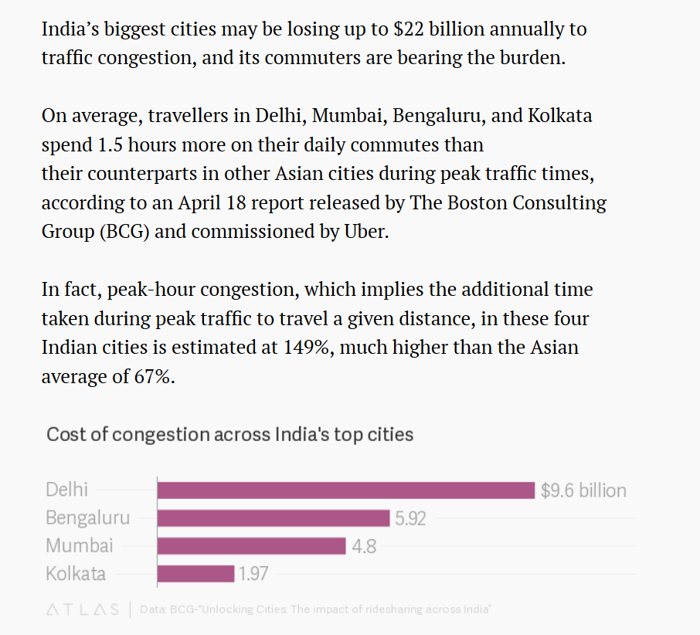
The Problems:
Real Time Traffic evaluation.
Traffic Congestion Management.
Traffic Occurrence and adherence.
Women Safety.

Slide 3
ONE Solution:
TRAFLOW

Slide 4
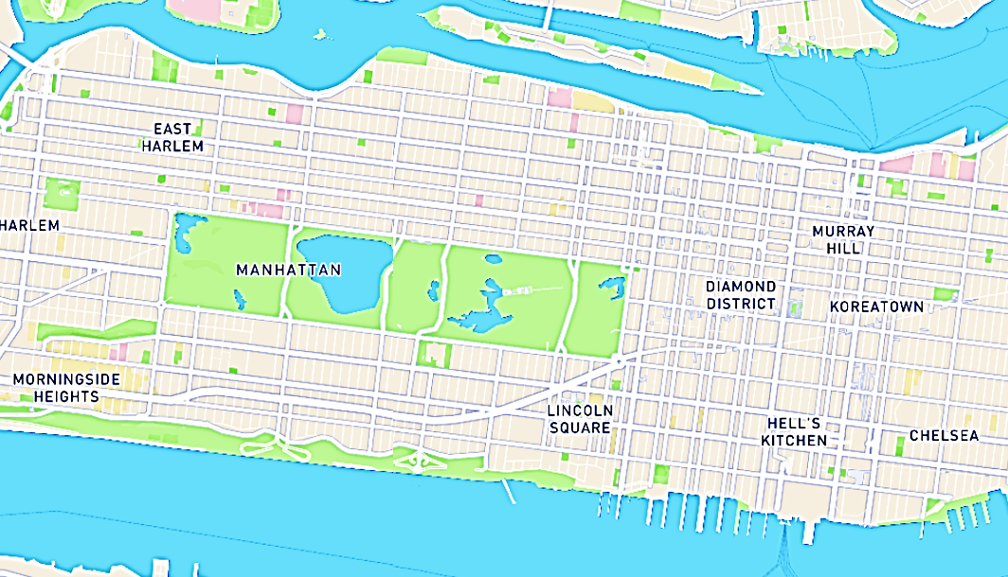


Shortest Path
Optimized Path
Traffic
*NOTE: Play Slide show to see animation for better understanding

Slide 5
The Solution:
RFID (Radio Frequency Identification)
Vehicle Detection.
Help to achieve Real-time Traffic evaluation.
Traffic Rule Adherence.

Slide 6
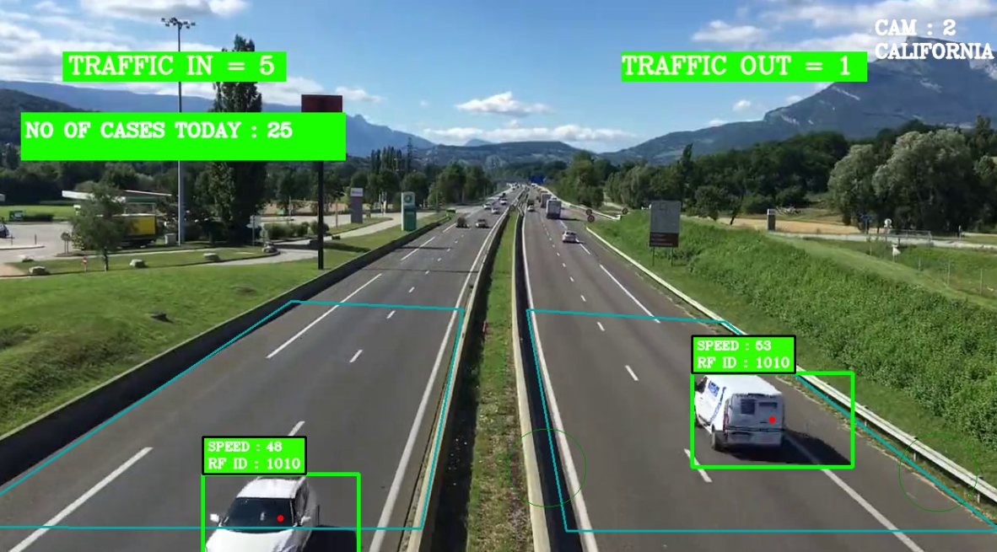
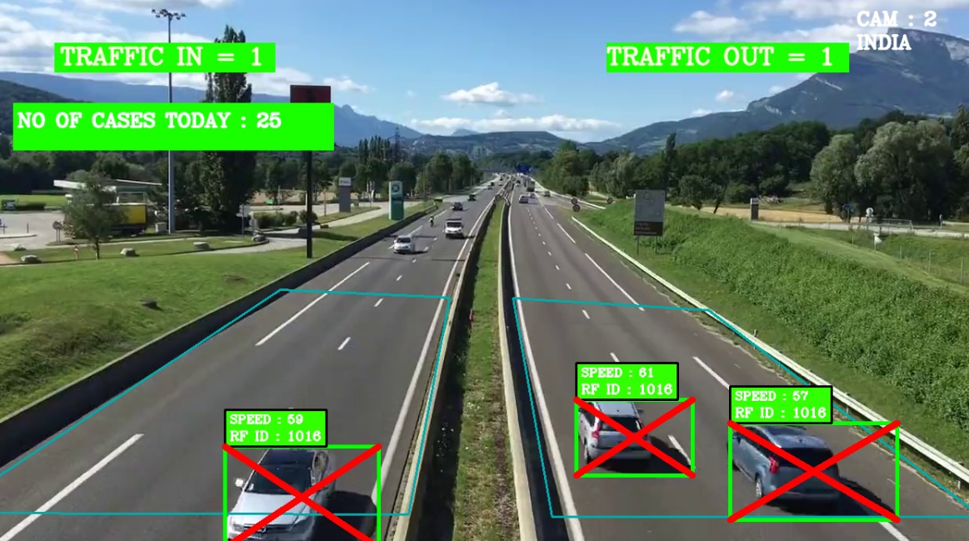

Slide 7
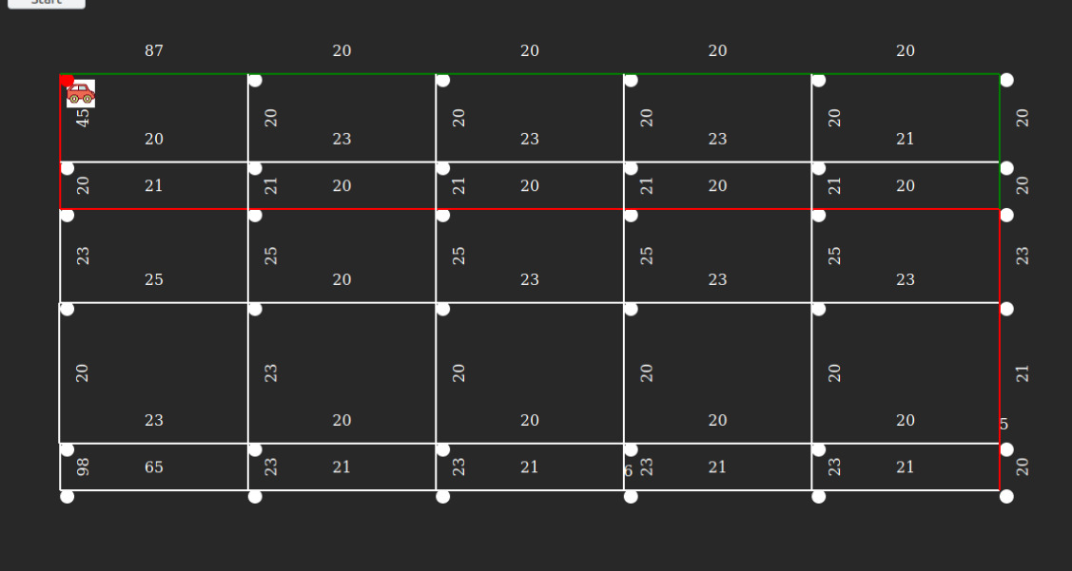
The Solution:
Optimal Path
Remove Traffic Congestion
Reach at destination on time.
Reduce the chance of traffic occurrence.

Slide 8
The Solution:
Security & Surveillance
Over speed warning
Package Tracing, Stolen vehicle tracing.
Decreasing Accident rate.
Ambulance.

Slide 9
The Solution:
Women Safety
By alerting and notifying nearby people for her help in the efficient and safest way possible.
Using BlockChain.

Slide 10

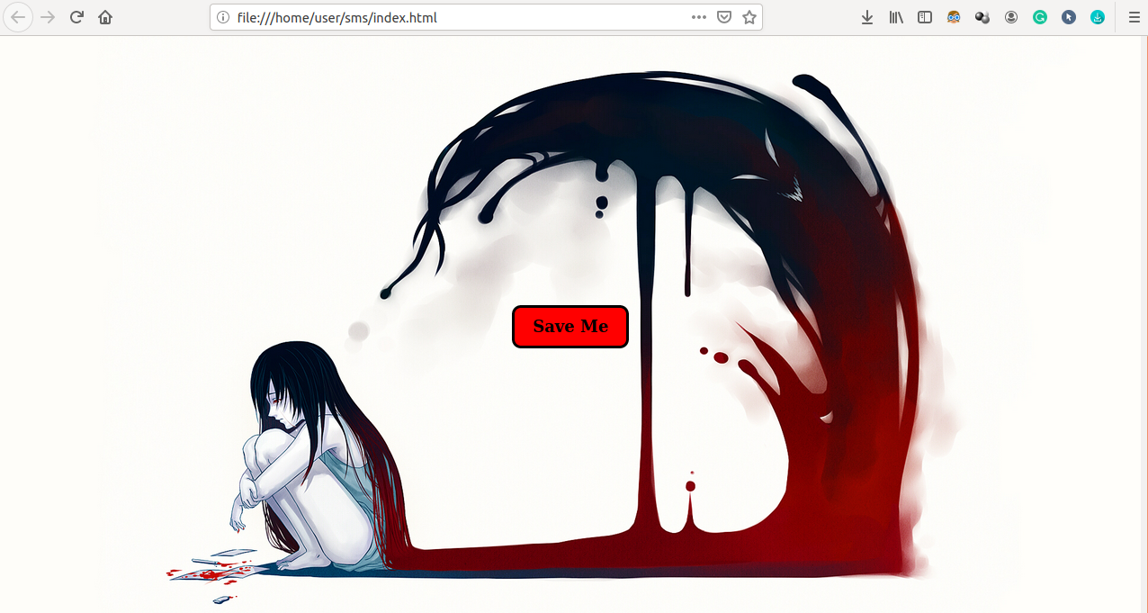
The Solution:
Women Safety
.
Auto Calling system (Notification)

Slide 11
FUTURE REALM:
Data mining and Analysis.
Traffic prediction.
Automatic invoice on traffic rules broken

Slide 12


